Slide 1



GIT - Branch
Presented By : Pratibha

Slide 2
Content
Introduction
Importance of Branches
Workflow
Branch Management
References

Slide 3
Introduction
Git is the most commonly used version control system. Git tracks the changes you make to files, so you have a record of what has been done, and you can revert to specific versions should you ever need to. Git also makes collaboration easier, allowing changes by multiple people to all be merged into one source.
A branch refers to a specific line of code that programmer’s collaborating on a project employ to make new commits. Git identifies the original branch as the master/main branch/default branch. When creating additional commits, the master/main branch will always connect you to the last changes that you will make.

Slide 4

Importance Of Branches
Git branches come to the rescue at many different places during the development of a project. As mentioned above, branches create another line of development that is entirely different or isolated from the main stable master branch. There are many advantages to doing so. Consider that you are developing a project with your team, and you finish a feature. You contact the client to request them to see the feature, but they are too busy, so you send them the link to have a look at the project. Okay, it's lengthy to explain in words. Let's see the same project development in different phases through images.

Slide 5

Workflow
Git branching enables a team of developers to develop copies of the production they are working on. While working in the git environment, they can add new features and also fix bugs. Once they are satisfied with the changes, git will allow merging the changes into the main production.
To identify the initial branch from other branches, you will use the “$ git init” command.
Whenever you create a new commit, git identifies it with a unique identifier code to track the changes.
Note that while working in git space the head will always point to the latest commit unless you switch it to another using “git checkout <branch>” command.

Slide 6
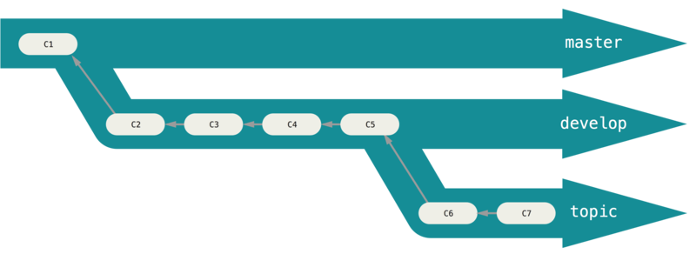
Workflow
Long-running branch
A long-running branch is a branch under active development that is not merged to the main trunk branch for a long time. The main trunk might be, for example, master or develop , from now on I'll refer to this as master

Slide 7
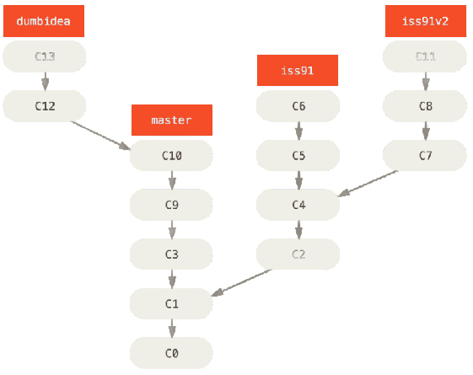
Workflow
Topic Branch
A topic branch is a short-lived branch that you create and use for a single particular feature or related work.

Slide 8

Branch Management
Branches are the heart of Git. From the time of creating the repository until its deletion, everything will involve branches. So this is a concept to remember and analyze carefully. In this tutorial, we discussed the definition and importance of branches. This complete section of branches on ToolsQA will take you through some operations and concepts that will help you in efficiently using Git.

Slide 9


Branch Management
These are the most common commands that are being used in branch management.
Create New Branch
This is the first step in the process, you can start on a default branch or create a new branch for the development
Command

Slide 10

Branch Management
Switch Branch
This step is to be used when a developer want to switch between multiple branches.
Command

Slide 11
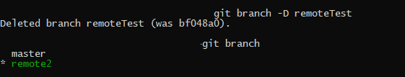
Branch Management
Delete Branch
An already running branch can delete from your Git repository. Deleting a branch can help when the branch has done its job, i.e., it's already merged, or you no longer need it in your repository for any reason.
Command

Slide 12

Branch Management
Show All Branch
This step is used when a developer want to view the list of all the branches.
Command

Slide 13
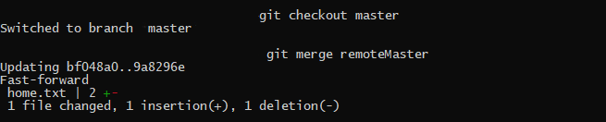
Branch Management
Merge Branch
An already running branch can merge with any other branch in your Git repository. Merging a branch can help when you are done with the branch and want the code to integrate into another branch code.
Command

Slide 14

References
GeeksForGeeks
FreeCodeCamp
Edureka
CodeWithHarry
Quora

Slide 15
Thank You!

